Slide 1

Battle of neighborhoods
- Sandeep Chandy

Slide 2


Business Problem
A chain of coffee shops wants to find suitable locations in downtown Toronto to set up its first outlet.

Slide 3
POSSIBLE SOLUTION
Leverage location intelligence to identify groups of neighborhoods that are similar in characteristics
Obtain location information from a location data provider such as Foursquare
Explore and clean the data
Apply K-Means clustering to segment neighborhoods based on concentration of venues
The resulting well separated segments will help the coffee business pick the best location

Slide 4
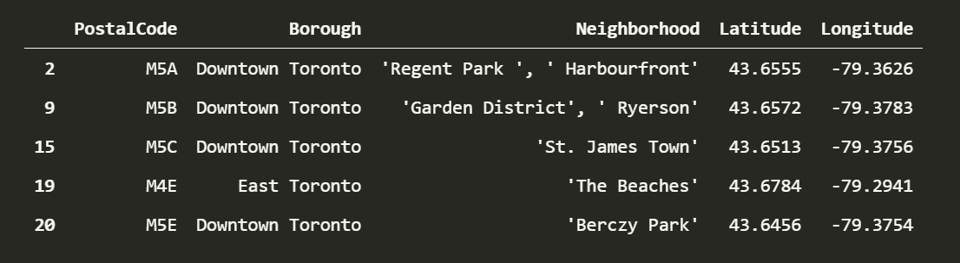
Data DESCRIPTION & preparation
Extracted information regarding postal code, boroughs and neighborhoods for Toronto from https://en.wikipedia.org/wiki/List_of_postal_codes_of_Canada:_M.
Cleaned and fit the text data into a dataframe with 3 columns – PostalCode, Borough and Neighborhood.
A smaller dataset focusing on Toronto was filtered from this data which contained the string ‘Toronto’ in the Borough field.

Slide 5
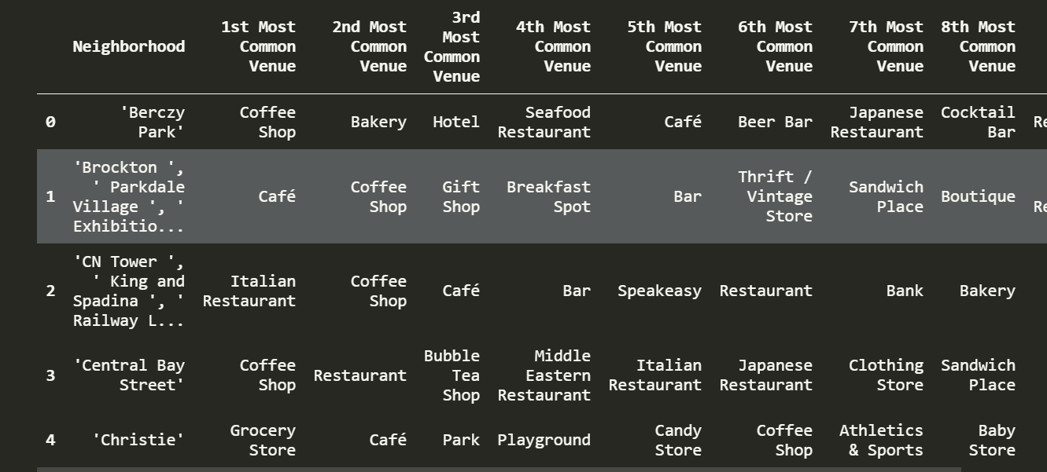
Data DESCRIPTION & preparation
A new dataframe containing information (name and category) for all venues within 500m of each neighborhood was generated and added to the original data frame
Encoded the venue categories and calculated the frequency of venues for each neighborhood.
Built a data frame containing neighborhood and top 10 most common venues using this data

Slide 6
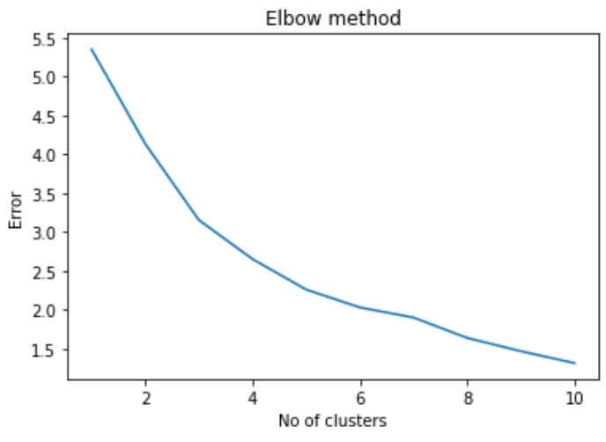
MODELLING : KMeans
Used K-Means clustering which divides the data into K non-overlapping groups.
Using elbow method 3 was chosen as the value of K.
Using kmeans method of Scikit Learn library a model is fit on the input data frame.
Cluster labels for each observation were then extracted from the model and appended to each observation.
Having this information each cluster was then analyzed to study neighborhoods and the common venues surrounding them.

Slide 7
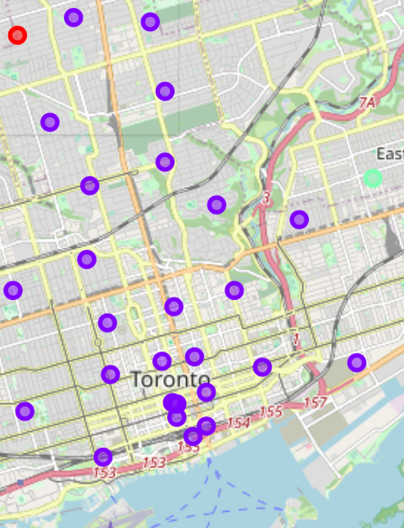
OBSERVATIONS
Out of the 3 clusters , cluster 0 has 3 neighborhoods, cluster 1 has 1 neighborhood and cluster 2 has the remaining neighborhoods.
From the analysis, it is evident that cluster 2 has neighborhoods with a high concentration of coffee shops , restaurants , bakeries, and other beverage shops which would mean high competition to the coffee business
Whereas clusters 0 and 1 have neighborhoods with lesser number of food business which means lower competition to the coffee business

Slide 8


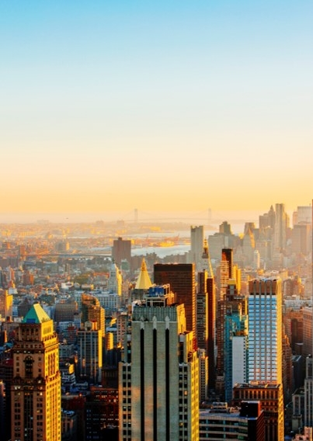

CONCLUSION
‘High Park’ , ‘Roselawn’, ‘Lawrence Park’ and ‘Danforth East’ were identified as best target neighborhoods for the coffee business.
Other factors including proximity to public transit, commercial spaces, rental cost need to be considered for a holistic decision.

Slide 9
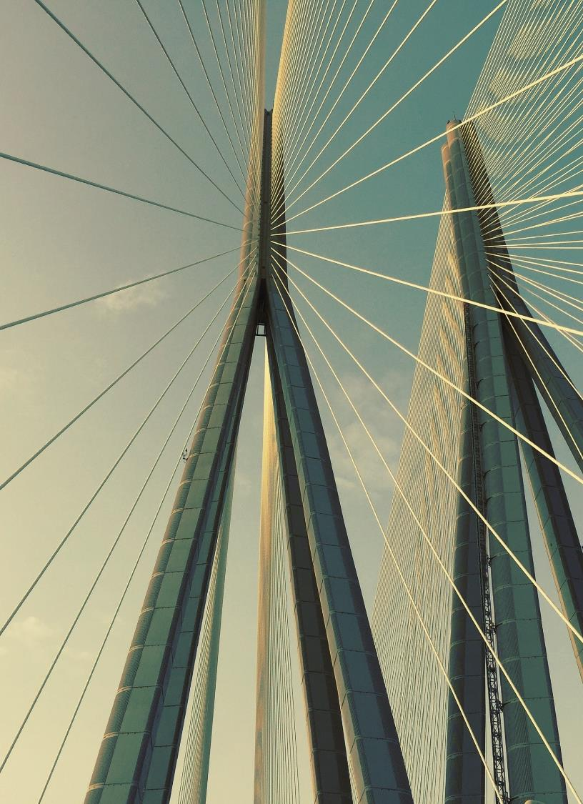
Thank you
Sandeep Chandy
Email Address
Website Address

